Slide 1
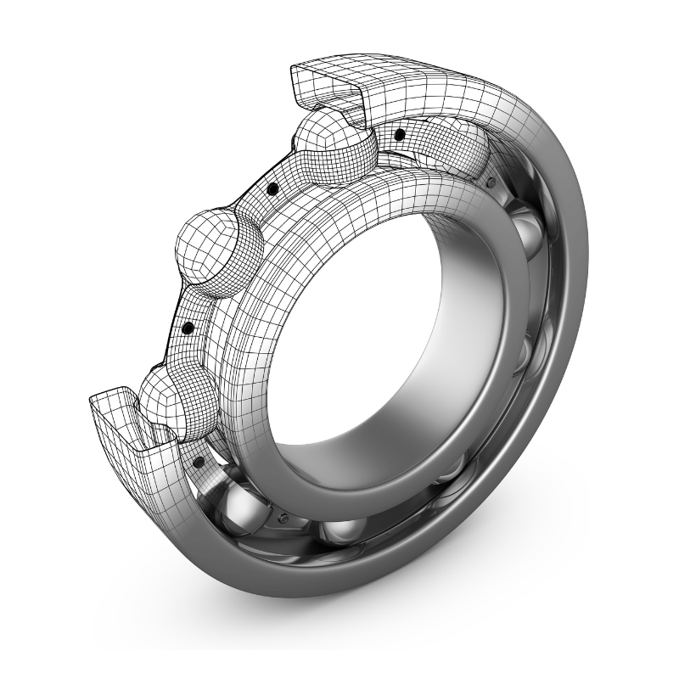
고열 베어링 200/250/350도
www.pitchkorea.com

Slide 2
HT200 최대 사용 온도 : 200도
HT280 최대 사용 온도 : 280도
HT350 최대 사용 온도 : 350도 * 작동 스피드는 0~250 rpm 이하로 제한
공통 적용 사항 스틸 리벳 케이지 C4 클리어런스 틈새 2ZR 실링 봉인 인산 망간 코팅
HT200 Temperature limited : 200℃
HT280 Temperature limited : 280℃
HT350 Temperature limited : 350℃ * Operating speed must be 0~250 rpm.
Components of common application Steel rivet cage C4 clearance 2ZR sealing Phosphated coating

Slide 3
HT200 - 60
Bearing | d | D | B | Limited speed |  |  | Weight
Code | mm | mm | mm | 2ZR-HT200 | 2ZR-HT250 | 2ZR-HT350 | kg
6000 | 10 | 26 | 8 | 6,290 | 2,330 | 250 | 0.02
6001 | 12 | 28 | 8 | 6,090 | 2,180 | 220 | 0.03
6002 | 15 | 32 | 9 | 5,860 | 2,020 | 190 | 0.03
6003 | 17 | 35 | 10 | 5,560 | 1,850 | 170 | 0.04
6004 | 20 | 42 | 12 | 5,450 | 1,650 | 150 | 0.07
6005 | 25 | 47 | 12 | 5,000 | 1,430 | 130 | 0.08
6006 | 30 | 55 | 13 | 4,480 | 1,150 | 120 | 0.13
6007 | 35 | 62 | 14 | 4,100 | 1,030 | 100 | 0.16
6008 | 40 | 68 | 15 | 3,700 | 930 | 90 | 0.20
6009 | 45 | 75 | 16 | 3,300 | 830 | 80 | 0.25
6010 | 50 | 80 | 16 | 2,900 | 730 | 80 | 0.28
6011 | 55 | 90 | 18 | 2,500 | 630 | 70 | 0.40
6012 | 60 | 95 | 18 | 2,130 | 560 | 60 | 0.41
6013 | 65 | 100 | 18 | 1,920 | 510 | 50 | 0.42
6014 | 70 | 110 | 20 | 1,690 | 480 | 50 | 0.60

Slide 4
HT200 - 62
Bearing | d | D | B | Limited speed |  |  | Weight
Code | mm | mm | mm | 2ZR-HT200 | 2ZR-HT250 | 2ZR-HT350 | kg
6200 | 10 | 30 | 9 | 6,060 | 2,240 | 230 | 0.04
6201 | 12 | 32 | 10 | 5,630 | 2,010 | 200 | 0.04
6202 | 15 | 35 | 11 | 5,520 | 1,730 | 180 | 0.05
6203 | 17 | 40 | 12 | 5,380 | 1,540 | 160 | 0.07
6204 | 20 | 47 | 14 | 5,000 | 1,350 | 140 | 0.11
6205 | 25 | 52 | 15 | 4,550 | 1,230 | 130 | 0.13
6206 | 30 | 62 | 16 | 4,100 | 1,050 | 110 | 0.20
6207 | 35 | 72 | 17 | 3,700 | 930 | 90 | 0.30
6208 | 40 | 80 | 18 | 3,300 | 830 | 80 | 0.38
6209 | 45 | 85 | 19 | 3,050 | 760 | 80 | 0.43
6210 | 50 | 90 | 20 | 2,590 | 650 | 70 | 0.47
6211 | 55 | 100 | 21 | 2,220 | 560 | 60 | 0.62
6212 | 60 | 110 | 22 | 1,960 | 520 | 50 | 0.79
6213 | 65 | 120 | 23 | 1,720 | 450 | 50 | 0.98
6214 | 70 | 125 | 24 | 1,580 | 450 | 50 | 1.06

Slide 5
HT200 - 63
Bearing | d | D | B | Limited speed |  |  | Weight
Code | mm | mm | mm | 2ZR-HT200 | 2ZR-HT250 | 2ZR-HT350 | kg
6300 | 10 | 35 | 11 | 5,670 | 1,890 | 200 | 0.06
6301 | 12 | 37 | 12 | 5,520 | 1,730 | 190 | 0.07
6302 | 15 | 42 | 13 | 5,380 | 1,580 | 170 | 0.09
6303 | 17 | 47 | 14 | 5,000 | 1,430 | 150 | 0.12
6304 | 20 | 52 | 15 | 4,580 | 1,270 | 140 | 0.16
6305 | 25 | 62 | 17 | 4,170 | 1,040 | 120 | 0.24
6306 | 30 | 72 | 19 | 3,710 | 840 | 100 | 0.36
6307 | 35 | 80 | 21 | 3,290 | 750 | 90 | 0.48
6308 | 40 | 90 | 23 | 2,900 | 660 | 80 | 0.64
6309 | 45 | 100 | 25 | 2,500 | 570 | 70 | 0.85
6310 | 50 | 110 | 27 | 2,170 | 520 | 60 | 1.10
6311 | 55 | 120 | 29 | 1,960 | 480 | 60 | 1.39
6312 | 60 | 130 | 31 | 1,750 | 430 | 50 | 1.75
6313 | 65 | 140 | 33 | 1,560 | 380 | 50 | 2.07
6314 | 70 | 150 | 35 | 1,380 | 390 | 50 | 2.51

